Slide 1
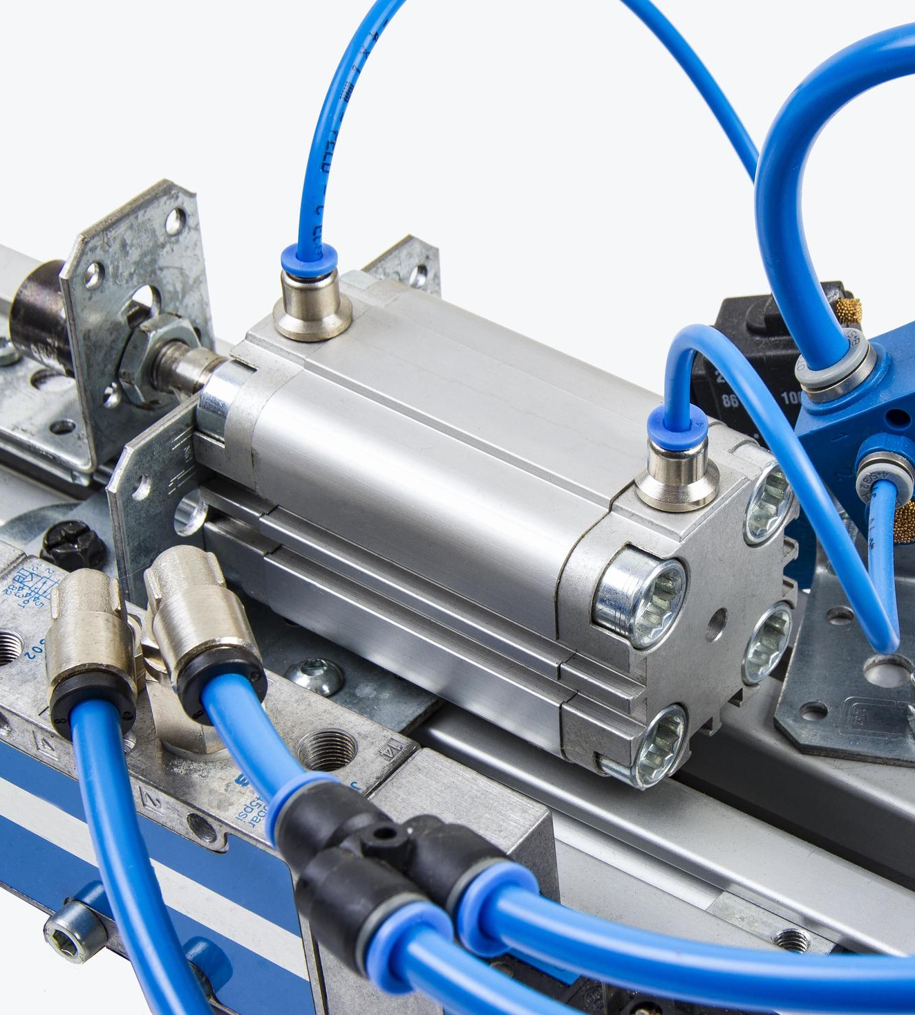
Introduction to Pneumatic and Hydraulic Systems
Understand the basic principles, applications, and differences between pneumatic and hydraulic systems
-Akbar Q
Notes:
1

Slide 2
Agenda
Overview of pneumatic and hydraulic systems
  Applications in manufacturing, construction, automotive, etc.
  Advantages vs. disadvantages (e.g., noise, reliability)
Units used in Pneumatic and Hydraulic Systems
  PS units (pounds per square inch, inches, etc.)
  HU units (Pascals, Newtons, meters, etc.)
Notes:
2

Slide 3
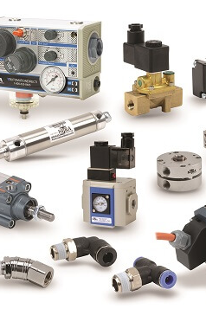
The Medium
What do you think is the difference between hydraulic and pneumatic systems?
Notes:
3

Slide 4
Find Out
Three Applications of Hydraulic and Pneumatic Systems that you have personally observed in daily life.
Notes:
4

Slide 5

Why Bother with Fluids?
Weight savings
Space savings
Temperature resistance
No EMI
Notes:
5

Slide 6
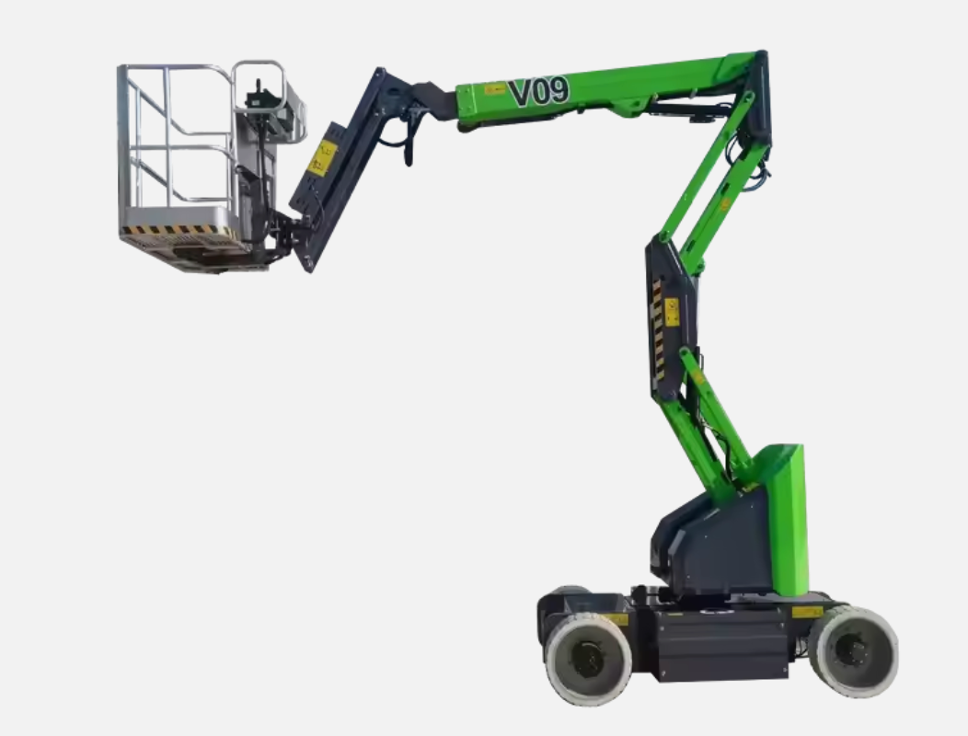
Weight Savings
Heavy Pumps and Reservoirs are in the back
Maintains Centre of Gravity
Notes:
6

Slide 7
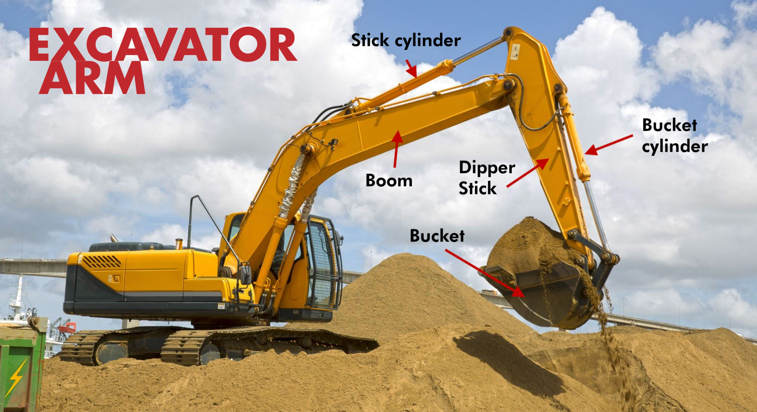
Mission
What is the reason the company exists?
Do you have an official company mission statement?
Notes:
7

Slide 8
Space Savings
Heavy Pumps and Reservoirs are in the back
Actuators are lightweight and attach to control arms
Notes:
8

Slide 9

More Extreme Environments
High Temperature Resistance can be Achieved with Metal Plumbing
Example of an Oven Press
Notes:
9

Slide 10
Prime Mover Key Differences:
Liquid
Gas
Notes:
10

Slide 11
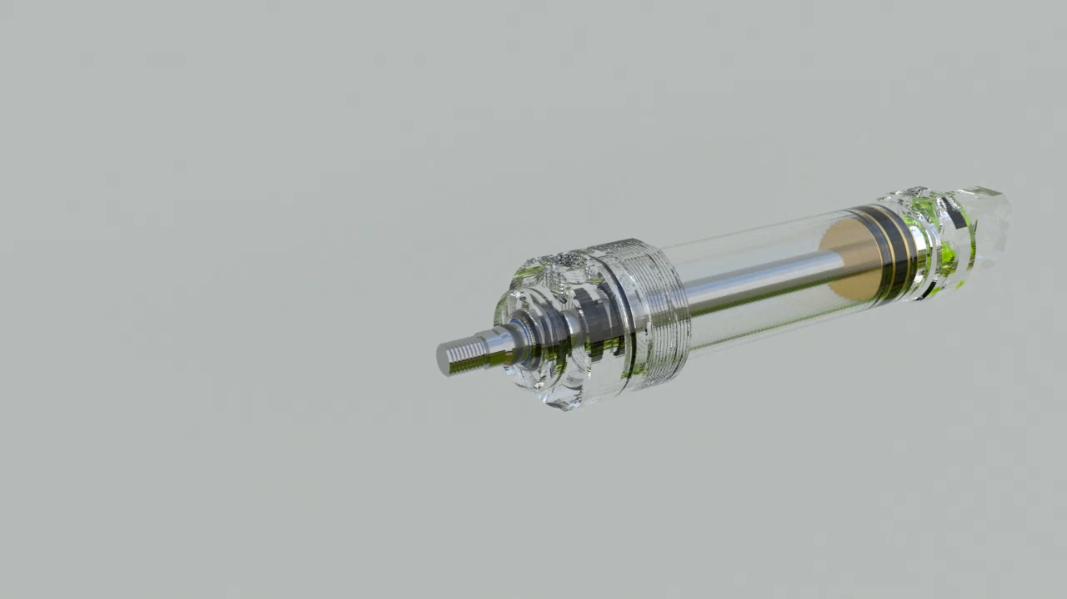
How they Work – Hydraulics
Notes:
11

Slide 12
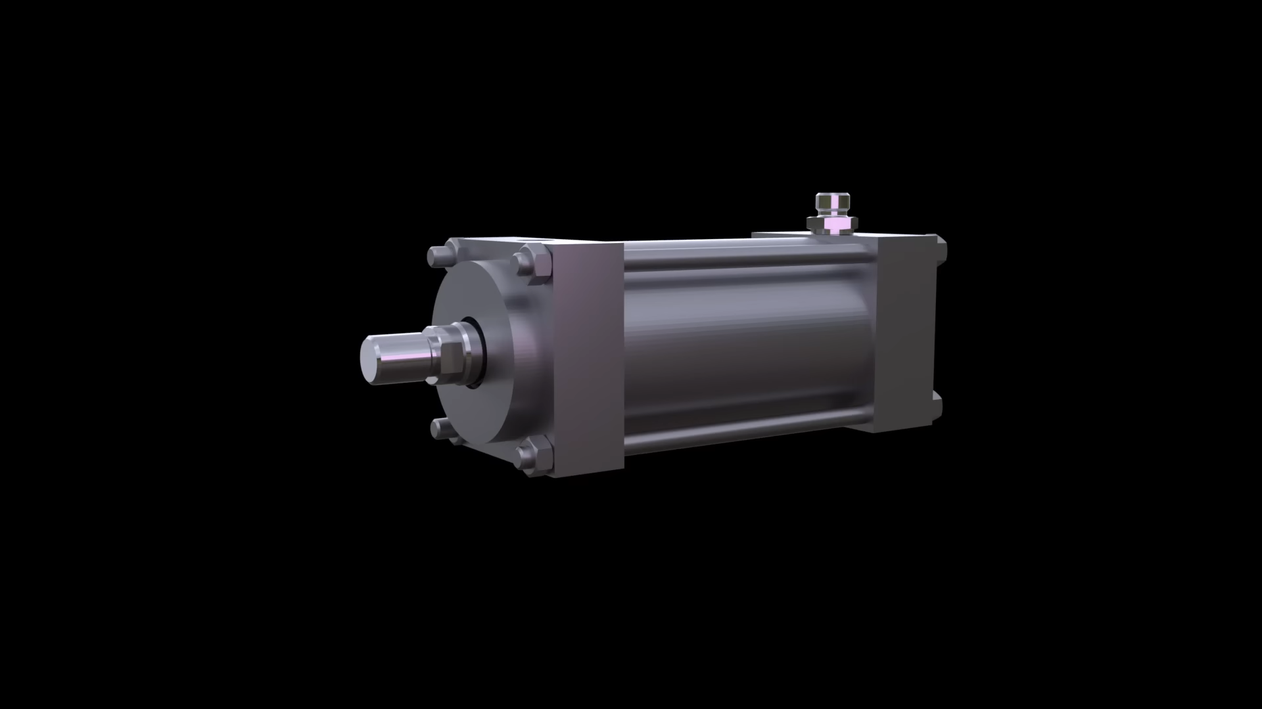
How they Work – Pneumatics
Notes:
12

Slide 13
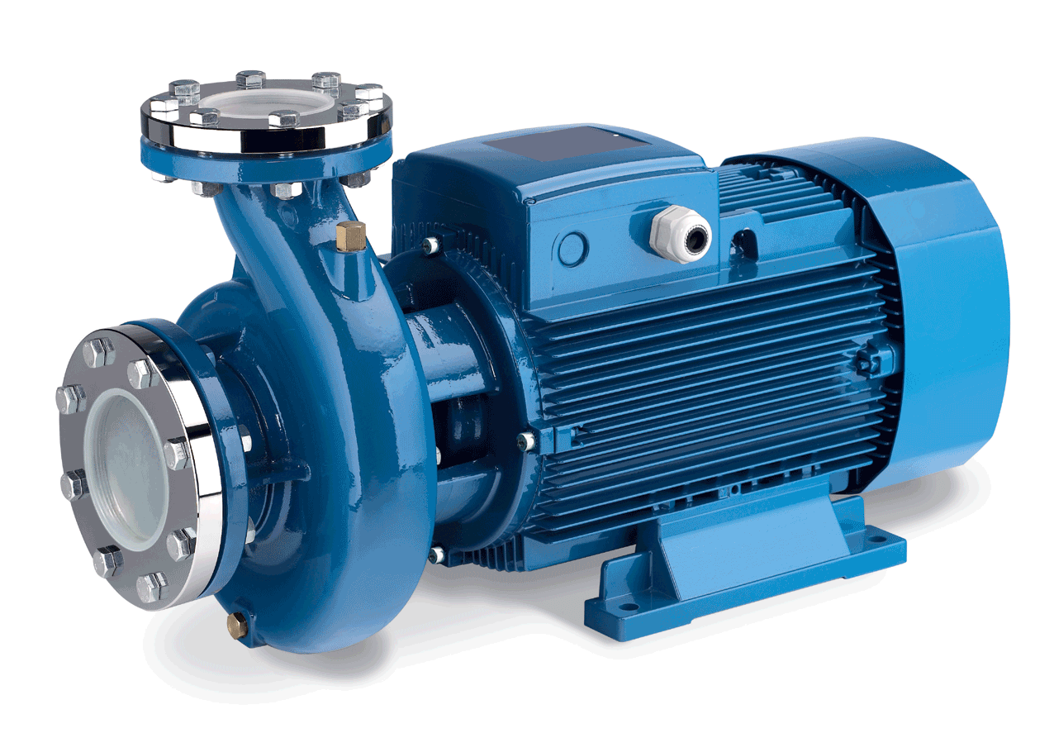
Pumps
They are Used to Move and Pressurize Fluids
Notes:
13

Slide 14
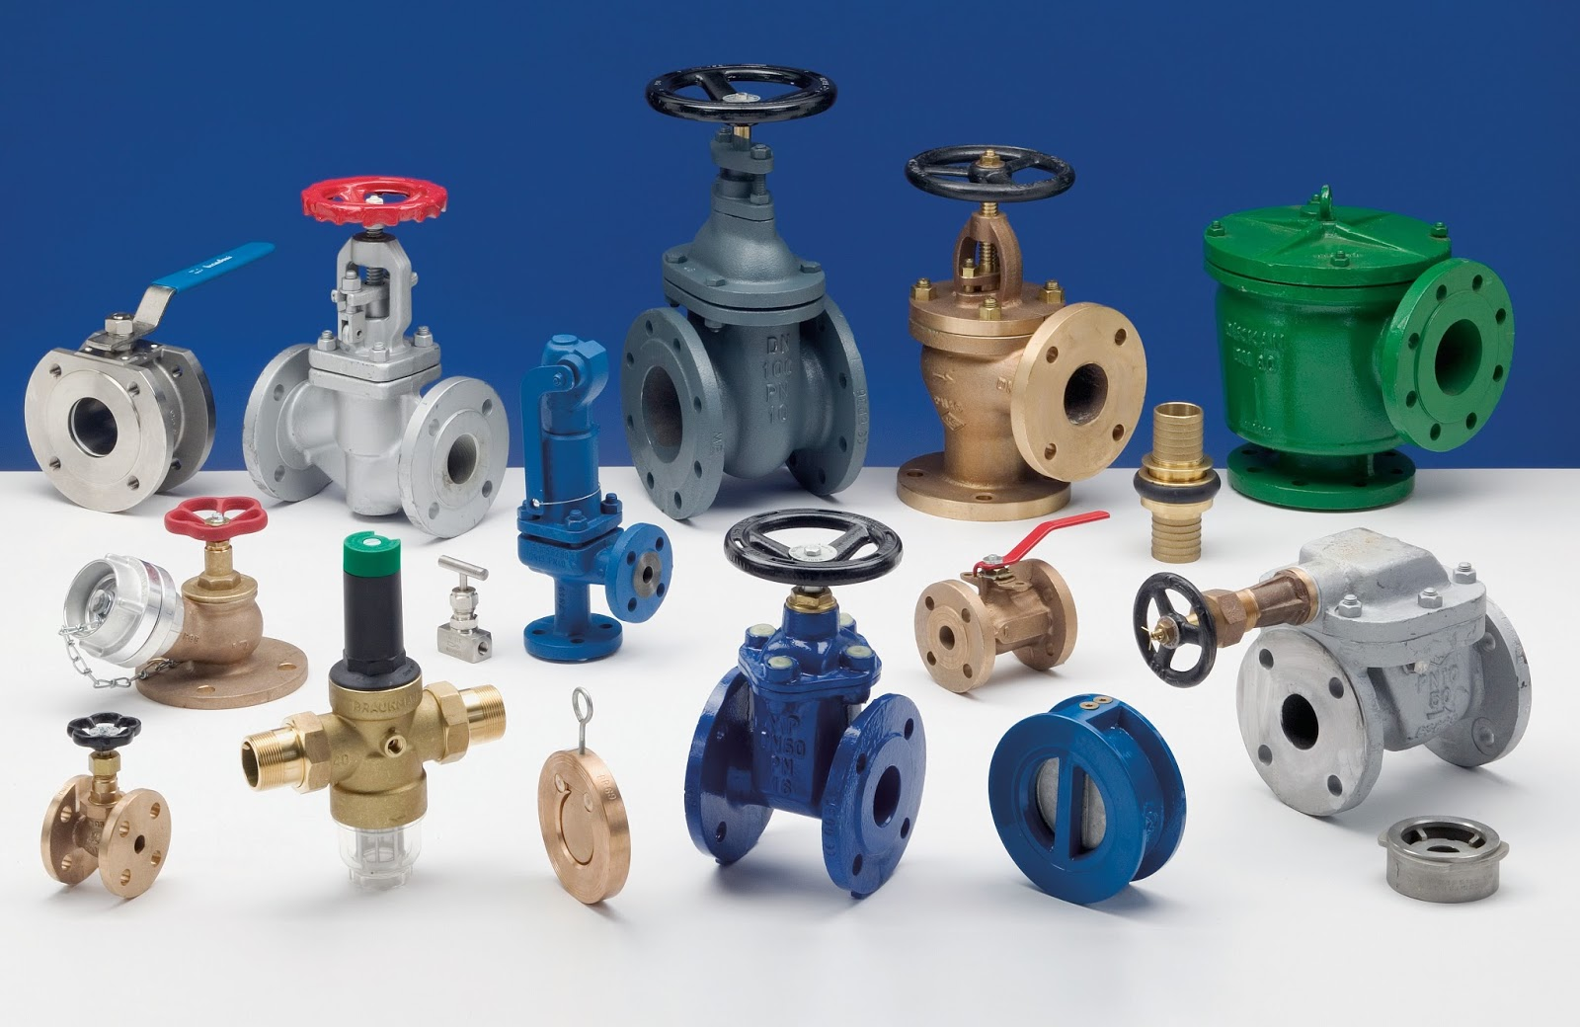
Notes:
14

Slide 15
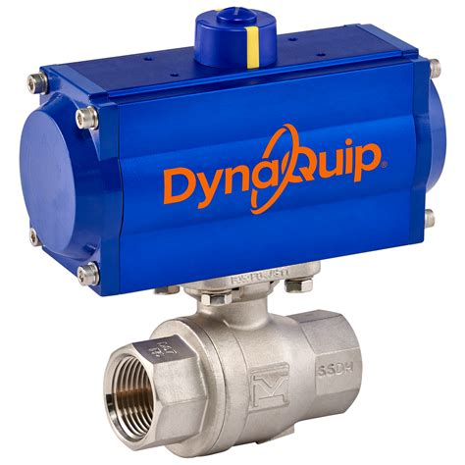
Valves
They are Used to Control Flow
Notes:
15

Slide 16

Tanks
They are Used to Hold Fluid as Buffer
Notes:
16

Slide 17

Hydraulic Fluid is Pushed in and out
Notes:
17

Slide 18

Tanks
Compressor Stores Pressurized Air in Tanks
Notes:
18

Slide 19
Overview
Definition and Key Differences:
Advantages vs. Disadvantages:
  Hydraulic systems: Use liquids (e.g., oil) to transmit power.
  Pneumatic systems: Use compressed air or gas to transmit power.
Hydraulics: High force, precise control, but prone to leakage.
Pneumatics: Clean, fast, but lower force compared to hydraulics.
Notes:
19

Slide 20

What do They Use?
Press
Notes:
20

Slide 21

What do They Use?
Hammer
Notes:
21

Slide 22
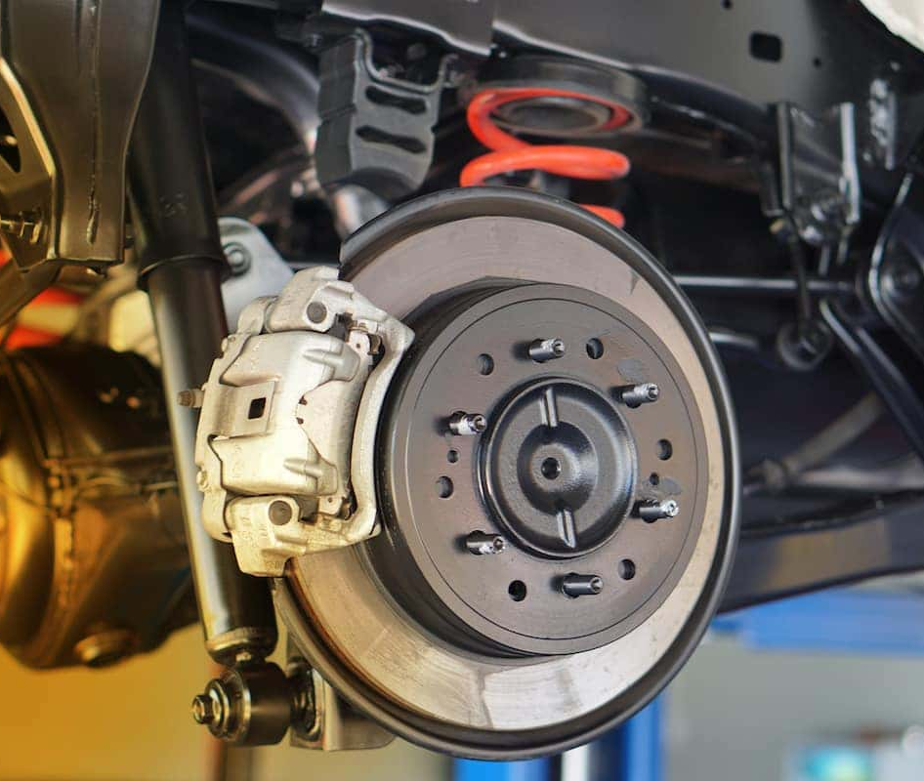
What do They Use?
Car Brakes
Notes:
22

Slide 23
Units to Know
Pressure:
Pascals (Pa)
Force:
Newtons (N)
Distance:
Meters (m)
Notes:
23

Slide 24

Case Study
Form 2 Groups and find an industry and a system utilized in that industry
Design a basic system and determine whether hydraulic or pneumatics actuators should be used and why
Notes:
24

Slide 25

Let’s Spec Out the System
Which Actuator Should be Used for Which Axis?
Hydraulic and Pneumatic Medium Available
Linear Motor Pressurization and Pump Available
Notes:
25

Slide 26

Let’s Spec Out the System
Pump is fast and High Volume but Low Pressure
Notes:
26

Slide 27
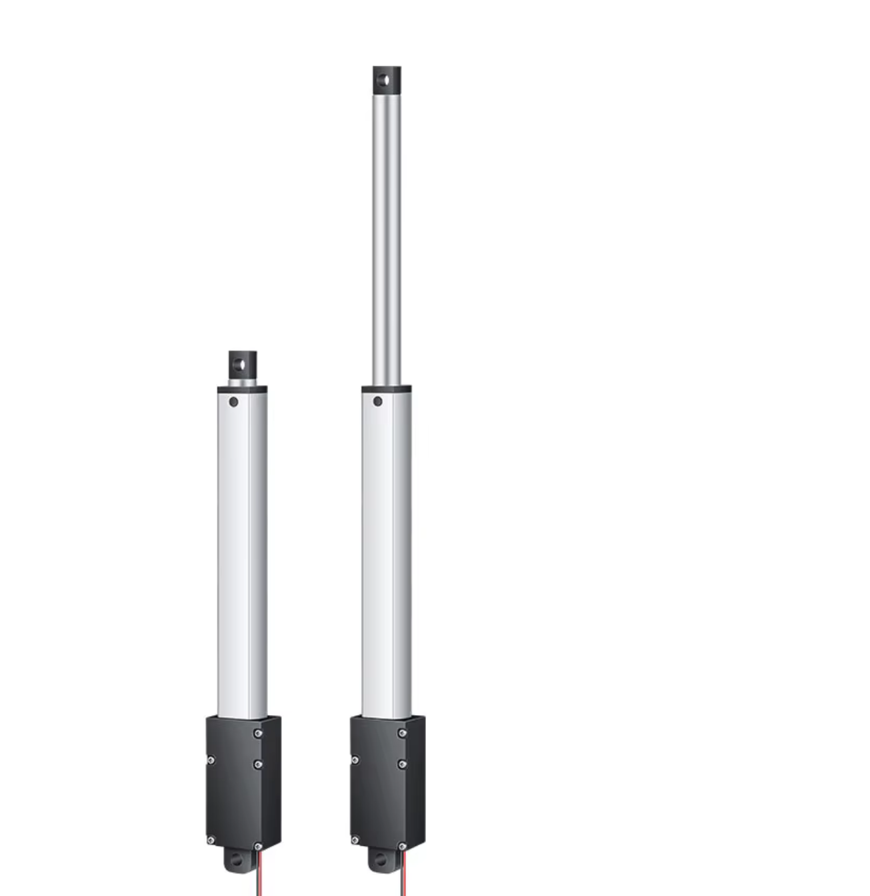
Let’s Spec Out the System
Linear Motor is Slow but High Amount of Force
Notes:
27

Slide 28

Let’s Spec Out the System
Air Compresses but is lightweight and will have some give to the force applied
Notes:
28

Slide 29

Let’s Spec Out the System
Liquid Does not Compress but will Hold Firm Force
Notes:
29

Slide 30
Why Should we Use Syringes?
HomeWork Task
Notes:
30

Slide 31
Thank you
Continue on the build of the ARM
Notes:
31

